Slide 1



Taylor’s Theorem
Emircan Gezer | 21050170

Slide 2

Overview
01
02
03
04
Idea of Taylor’s Theorem
What is Taylor’s Theorem
Example on Cosine
Example on $e^{x}$

Slide 3


01
Idea of Taylor’s Theorem

Slide 4
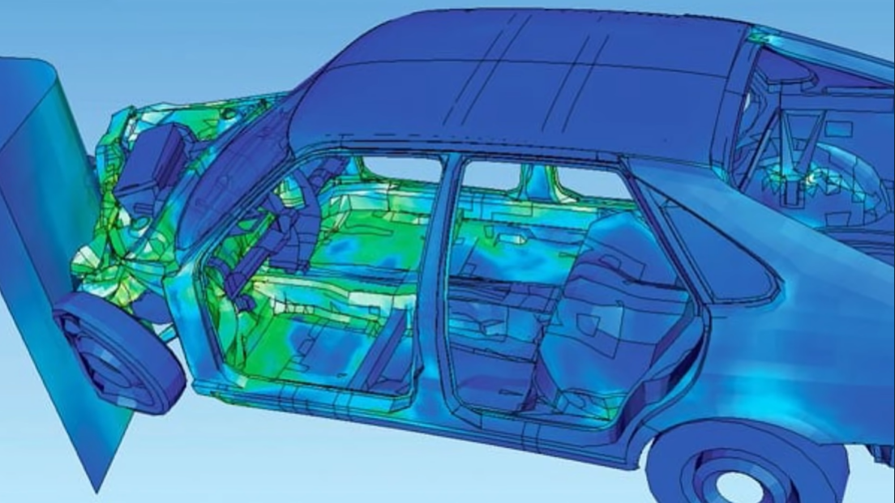

Slide 5
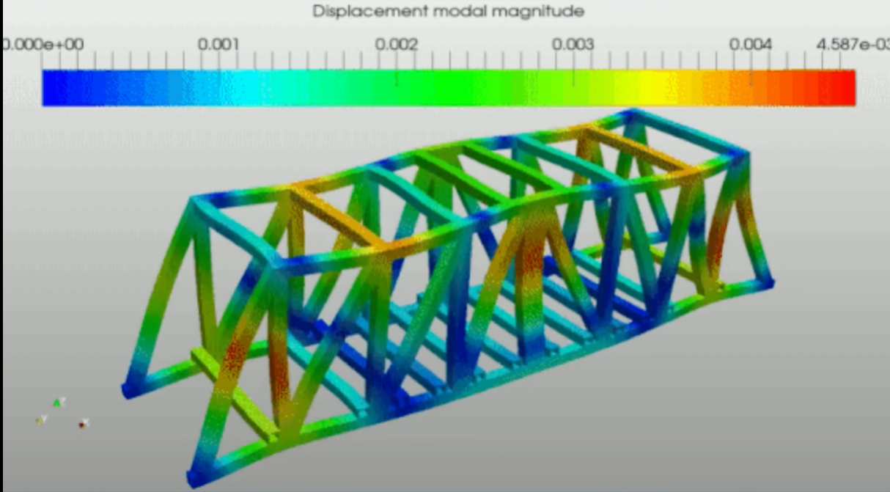

Slide 6


Slide 7
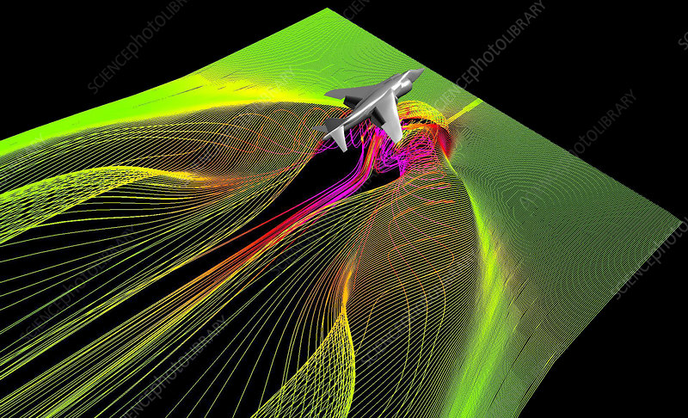

Slide 8
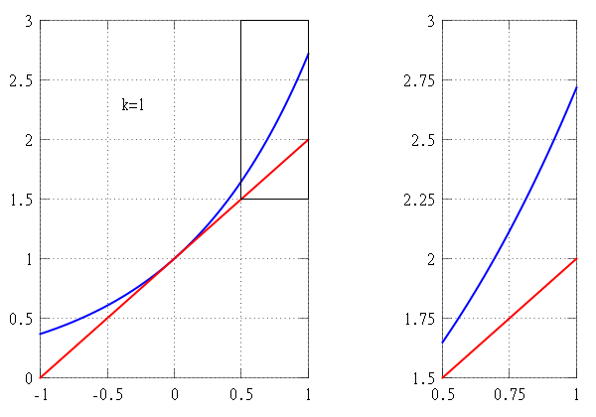
Approximation

Slide 9
02
What is Taylor’s Theorem

Slide 10
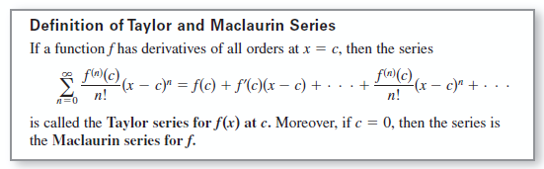
Definition

Slide 11
03
Example On Cosine

Slide 12
1. Graph
https://www.desmos.com/calculator/rbj2mrue6m?lang=tr

Slide 13

$$\cos{(0.1)}= \text{0}\text{.}\text{9950042}\text{…}$$

Slide 14

04
Example on $e^{x}$

Slide 15
2. Graph
https://www.desmos.com/calculator/jis0ftufwx?lang=tr

Slide 16
Definition

Slide 17
Thank you for your attention!

Slide 18
References
https://www.youtube.com/watch?v=3d6DsjIBzJ4
https://www.youtube.com/watch?v=eX1hvWxmJVE
https://www.desmos.com/calculator/yzaoib4lbq?lang=tr
https://www.desmos.com/calculator/8xqembw2pb?lang=tr
https://www.desmos.com/calculator/jis0ftufwx?lang=tr
https://mathworld.wolfram.com/TaylorsTheorem.html
https://math.hmc.edu/calculus/hmc-mathematics-calculus-online-tutorials/single-variable-calculus/taylors-theorem/

